Slide 1
Name :- Sharma Deepak R. Branch :- E.C 1st sem. Enrollment no. :- 130670111071 Subject :- E.M.E

Slide 2
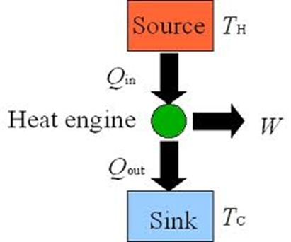
HEAT ENGINES
Heat engine is tha converts chemical energy of fule into heat energy and this heat energy is ultilized converting to mechanical work.heat engine mainly consist of a source of heat a mediam to carry the heat energy and a converting machine.genrally source of heat is combustion chamber or furnace where combustion of fuel take place . Heat is continuously supplied to the mediam from combuation chamber for conversion mechanical work

Slide 3
SOURCES OF HEAT
Chemical energy : The chemical energy of solid,liquid,gaseous fule is converted into heat energy by burning of fule
Nuclear energy : Nuclear energy or atomic energy it recent development.heat energy produse by fisson and fusion atome me be used to produse shaft power
Heat energy : Heat energy mebe obtain directly frome the various natural resoures such as solar radiation ,geothermal energy etc.

Slide 4
CLASSIFICATION OF HEAT ENGINES
E.C.Engines I.C.Engines In ec engines heat combustion product in ic engine heat directly as working
Is transferd to working fluid of the cycle fluid.
steam enegin steam turbine is example petrol disal gas engine is example of
of ec engine ic engine

Slide 5
HEAT ENGINE CYCLES
CYCLE
Carnot cycle
Ranking cycle
Otto cycle
Diesel cycle

Slide 6
CARNOT CYCLE
Reversible isothermal expansion of the gas at the "hot" temperature, T1. During this step. the gas is allowed to expand and it does work on the surroundings. The temperature of the gas does not change during the process, and thus the expansion is isothermal. The gas expansion is propelled by absorption of heat energy Q1 and of entropy \Delta S=Q_1/T_1 from the high temperature reservoir.
Isentropic (reversible adiabatic) expansion of the gas (isentropic work output). For this step the piston and cylinder are assumed to be thermally insulated, thus they neither gain nor lose heat. The gas continues to expand, doing work on the surroundings, and losing an equivalent amount of internal energy. The gas expansion causes it to cool to the "cold" temperature, T2. The entropy remains unchanged.
Reversible isothermal compression of the gas at the "cold" temperature, T2. Now the surroundings do work on the gas, causing an amount of heat energy Q2 and of entropy \Delta S=Q_2/T_2 to flow out of the gas to the low temperature reservoir.
Isentropic compression of the gas. Once again the piston and cylinder are assumed to be thermally insulated. During this step, the surroundings do work on the gas, increasing its internal energy and compressing it, causing the temperature to rise to T1. The entropy remains unchanged. At this point the gas is in the same state as at the start of step 1.

Slide 7
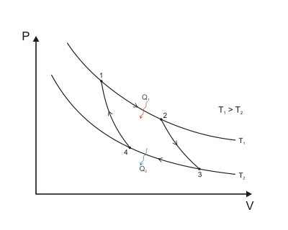
PV Graph
When the Carnot cycle is plotted on a pressure volume diagram, the isothermal stages follow the isotherm lines for the working fluid, adiabatic stages move between isotherms and the area bounded by the complete cycle path represents the total work that can be done during one cycle. Evaluation of the above integral is particularly simple for the Carnot cycle. The amount of energy transferred as work is
W = \oint PdV = (T_H-T_C)(S_B-S_A)
The total amount of thermal energy transferred between the hot reservoir and the system will be
Q_H=T_H(S_B-S_A)\,

Slide 8
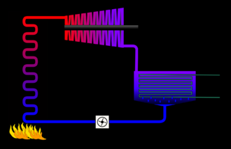
RANKINE CYCLE
The Rankine cycle closely describes the process by which steam-operated heat engines commonly found in thermal power generation plants generate power. The heat sources used in these power plants are usually nuclear fission or the combustion of fossil fuels such as coal, natural gas, and oil

Slide 9
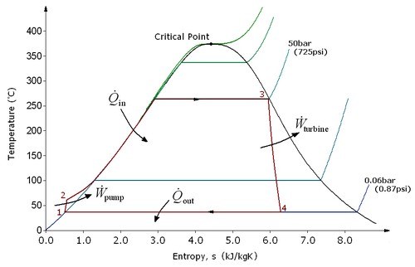
Process 1-2: The working fluid is pumped from low to high pressure. As the fluid is a liquid at this stage the pump requires little input energy.
Process 2-3: The high pressure liquid enters a boiler where it is heated at constant pressure by an external heat source to become a dry saturated vapour. The input energy required can be easily calculated using mollier diagram or h-s chart or enthalpy-entropy chart also known as steam tables.
Process 3-4: The dry saturated vapor expands through a turbine, generating power. This decreases the temperature and pressure of the vapour, and some condensation may occur. The output in this process can be easily calculated using the Enthalpy-entropy chart or the steam tables.
Process 4-1: The wet vapour then enters a condenser where it is condensed at a constant pressure to become a saturated liquid.

Slide 10
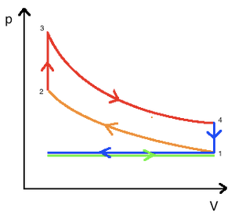
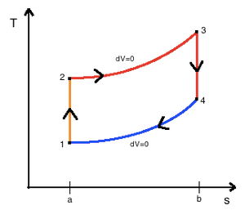
OTTO CYCLE
An Otto cycle is an idealized thermodynamic cycle which describes the functioning of a typical spark ignition reciprocating piston engine,[1] the thermodynamic cycle most commonly found in automobile
the intake (A) stroke is performed by an isobaric expansion, followed by an adiabatic compression (B) stroke. Through the combustion of fuel, heat is added in an isochoric process, followed by an adiabatic expansion process, characterizing the power (C) stroke. The cycle is closed by the exhaust (D) stroke, characterized by isochoric cooling and isentropic compression processes.
Top and bottom of the loop: a pair of quasi-parallel and isentropic processes (frictionless, adiabatic reversible).
Left and right sides of the loop: a pair of parallel isochoric processes (constant volume

Slide 11
Process 1-2 compression stroke
Piston moves from crank end to cylinder head end as the working gas with initial state 1 is compressed isentropically to state point 2, through compression ratio ({V}_{1}/{V}_{2}). Mechanically this is the isentropic compression of the air/fuel mixture in the cylinder, also known as the compression stroke. This isentropic process assumes there no mechanical energy is lost due to friction and no heat is transferred to or from the gas, hence the process is reversible. The compression process requires that mechanical work be added to the working gas. Generally the compression ratio is around 9-10:1 (V1:V2) for a typical engine.[6]
Process 2-3 ignition
The piston is momentarily at rest at TDC. At this instant the air/fuel mixture is compressed at the top of the compression stroke with the volume essentially held constant, also known as ignition phase. Heat is added to the working fluid at constant volume by the combustion of the injected fuel. The pressure rises and the ratio ({P}_{3}/{P}_{2}) is called the "explosion ratio".
Process 3-4 expansion stroke
The increased high pressure exerts a force on the piston and pushes it towards the BDC. Expansion of working fluid takes place isentropically and work is done by the system on the piston. The volume ratio ({V}_{4}/{V}_{3}) is called "isentropic expansion ratio". Mechanically this is the expansion of the hot gaseous mixture in the cylinder known as expansion stroke.
Process 4-1 idealized heat ejection
The piston is momentarily at rest at BDC. The working gas pressure drops instantaneously during a constant volume process as heat is removed as an idealized external sink is brought into contact with the cylinder head from point 4 to point 1. The exhaust valve opens at point 1 and the gas returns to state 1.

Slide 12
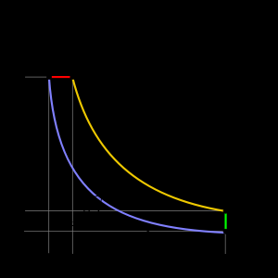
DIESEL CYCLE
The Diesel cycle is the thermodynamic cycle which approximates the pressure and volume of the combustion chamber of the Diesel engine, invented by Rudolph Diesel in 1897. It is assumed to have constant pressure during the first part of the "combustion" phas. This is an idealized mathematical model: real physical Diesels do have an increase in pressure during this period, but it is less pronounced than in the Otto cycle. The idealized Otto cycle of a gasoline engine approximates constant volume during that phase, generating more of a spike in a p-V diagram.

Slide 13
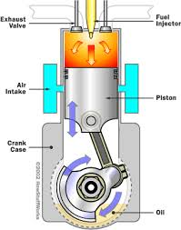
Process 1 to 2 is isentropic compression of the fluid (blue)
Process 2 to 3 is reversible constant pressure heating (red)
Process 3 to 4 is isentropic expansion (yellow)
Process 4 to 1 is reversible constant volume cooling (green)
The Diesel is a heat engine: it converts heat into work. The isentropic processes are impermeable to heat: heat flows into the loop through the left expanding isobaric process and some of it flows back out through the right depressurizing process, and the heat that remains does the work.
Work in (W_{in}) is done by the piston compressing the working fluid
Work out (W_{out}) is done by the working fluid expanding on to the piston (this produces usable torque)
Heat out (Q_{out}) is done by venting the air

